Slide 1
What Do The New AzMERIT Test Results Mean For My Child?

Slide 2

Expect More Arizona is…
A statewide nonpartisan organization dedicated to ensuring every Arizona child has access to a
world-class education, from the early years
through college and career
Notes:
Transition to introducing EMA. Share who EMA is. Share why our work is so important.

Slide 3


What We Stand For…
High Expectations & Excellence for Every Arizona child:
Kindergarten readiness
Early literacy
College and career readiness
Degree, certificate or credential attainment
Funding to support excellence for all
Great teachers & principals
Notes:
We are advocating for…
Every child has access to high quality early learning opportunities
Every 3rd grader is proficient in reading and math
Every student graduates from high school prepared for college and career
Every student has the opportunity to attain
a degree, credential or license
Every child’s education is funded birth through career to produce excellence
Every child has access to a great teacher in every classroom
More specifically, this year we are hoping to:
--retain high standards in Arizona classrooms
--ensure Arizona students have an assessment that is a meaningful tool that helps them succeed
--support teachers with the resources, PD and tools they need
--advocate for continued funding for early education, K-12 and higher education.

Slide 4

What We Do…
We are building an education-first culture and creating opportunities
for people to take action by:
Raising Awareness of Critical Issues
Building Public Support & Spotlighting Excellence
Moving Parents and Voters to Take
Action
Fostering Statewide Collaboration
Notes:
We do our work by raising awareness of critical education issues and creating opportunities for everyone to take action, in their homes, their local communities or statewide.
Raising Awareness of Critical Issues
Building Public Support & Spotlight Excellence
Moving Parents and Voters to Take Action
Fostering Statewide Collaboration to Create Change

Slide 5


Presentation Overview
What the new state test mean for your child
How to interpret test results
How teachers use test results
How to help your child succeed
Notes:
During today’s presentation, we will be sharing:
What the new state tests mean for your child
How to interpret test results
How teachers use test results
We will also share tips on how to help your child succeed and some tools and resources to help along the way

Slide 6

Why Do We Test?
Annual checkup to provide meaningful information to parents and teachers
Constant, objective benchmark to track your child’s progress
Notes:
Tests are not fun. However, they are a part of life from childhood to adulthood. They let us know we’re ready to move on. They reassure parents that their kids have mastered the skills they need to reach the next level. And they help schools know what kids need.
These tests are just like an annual checkup, just like his annual visit to the doctor to make sure he is healthy is an important opportunity to find out how your child is doing, and how they compare to other kids their age. Just as doctors check height and weight, teachers use the test to check how your child is doing in English and math.
Teachers will change from year to year. But the information from these tests will provide the constant, objective benchmark you can track over the course of your child’s education.

Slide 7
What is AzMERIT?
  AzMERIT = Arizona’s Measurement of Educational Readiness to Inform Teaching
  Arizona’s new statewide achievement test
  Unique to Arizona, developed based upon an Arizona test blueprint
  Represents just one of many measures that gauge your student’s progress
Notes:
Let’s start with an overview of what AzMERIT is.
AzMERIT is Arizona’s new statewide achievement test. It is an acronym that stands for:
AzMERIT = Arizona’s Measurement of Educational Readiness to Inform Teaching.
It replaces the AIMS test in reading, writing and math.
AzMERIT was developed with input by Arizona educators to give teachers a better idea of how students are doing.
Throughout the school year, there are many ways teachers assess how well students are doing in their classroom, including classwork, homework, quizzes, projects, and even teacher and counselor observations about your child’s growth. AzMERIT is one of those tools. The results, while meaningful, should be read in the context of everything you already know about your child.

Slide 8
AzMERIT Overview
Students in grades 3-11 take AzMERIT
Subjects: English Language Arts and Math
  Note: Students in Grades 4, 8 and high school will still take the AIMS Science test
Given via pencil/paper and online
  Schools selected to give it via computers or pencil/paper
  40% of schools took the test online last year
Notes:
Who takes AzMERIT?
Students in grades 3-11 take AzMERIT in math and English Language Arts which includes both reading and writing sections.
An important note that students in Grades 4, 8 and high school still take the AIMS Science test
AzMERIT is given by pencil/paper and online. Schools decide how to deliver the test.
About 40% gave the test online last year.

Slide 9
Why a New Test?
Aligned to what students are learning in classrooms today
AIMS set the bar too low
  Passing AIMS meant students met a minimum expectation for 10th grade
AzMERIT helps parents and teachers to know if their children are on track
  Passing AzMERIT will show that a student meets a high expectation for that grade
  Passing score means that students are on track for college and career
Notes:
So why did we need a new test?
What was being taught in the classroom didn’t match what was being assessed. We had teachers teaching and students learning higher standards and they didn’t correspond well with the old AIMS test.
AIMS also set the bar really low. As you might know, students would take AIMS in the 10th grade which they had to pass to graduate from high school. As a state, we were telling our kids that they were ready for college, career, and life basically if they had a 10th grade education.
In our globally competitive world where our kids are preparing for the jobs of the future and are having to compete with kids from around the world for those jobs, we know that a bar at a10th grade level wasn’t good enough.
AzMERIT gives parents and teachers a better tool to know if student are ready to move on to the next grade and are on track for college and career.
It matches what teachers are teaching and students are learning in the classroom.
In addition, AzMERIT is comparable across states, so we can see how Arizona students are doing compared to others across the country.

Slide 10
How is AzMERIT Different?
Provides a better indicator of what students are learning
Students are able to show their critical learning skills
  Applying concepts
  Showing deeper understanding of a topic
  Problem solving
Scores will be comparable across multiple states
Notes:
With the new test, parents will know if their child is on track academically or is falling behind. Students will know if they are prepared for the next grade and if they are on track for college and career. They will also have a chance to show their critical-thinking skills by applying concepts and showing deeper understanding of a topic.
Provides a better indicator of what students are learning
Students will be able to show their critical learning skills
Applying concepts
Showing deeper understanding of a topic
Problem solving
Given via computer and pencil/paper
Scores will be comparable across multiple states
Scores will be comparable with Utah, Florida, and states in the Smarter Balanced Consortia.

Slide 11
What You Need to Know
Elementary & Middle School Students
  Students take English and math tests at grade level
  Less testing time than AIMS
  ELL students participate along with most students with disabilities
  Alternative achievement tests are offered to eligible students with significant cognitive disabilities
Notes:
Students in 3rd through 8th grade will take AzMERIT in English Language Arts and Math at their grade level.
AzMERIT is shorter than AIMS for 3rd through 8th graders, which means students will spend less time taking state tests than in previous years.
ELL students participate along with most students with disabilities
Alternative achievement tests are offered to eligible students with significant cognitive disabilities

Slide 12
What You Need to Know
High School Students
  End of course tests
    English – tests given at the end of English courses in 9th, 10th and 11th grades
    Math – tests are given at the end of Algebra I, Geometry, and Algebra II
    Tests are given based on participation in these courses, rather than by grade
  Not required for high school graduation
    Additionally, students who did not pass AIMS are not required to retake AIMS in order to graduate
Notes:
In high school, students will take AzMERIT end-of-course tests in English Language Arts and Math. AzMERIT will be administered to high school students enrolled in English classes in 9th through 11th grade, and Algebra I, Geometry, and Algebra II.
Students will not be required to pass the assessment for graduation. As of Feb. 2015, students do not need to pass AIMS to graduate. Beginning with the class of 2017, all students will need to pass a civics test for graduation.

Slide 13
What Does the Test Look Like?
Goes beyond the bubble test
  Students are required to show their work
  Extended writing and multi-step questions will ask students to apply the skills and have a deep understanding of what they have learned
Untimed, so your child is given as much time as needed
Includes a writing portion, two reading portions and two math portions
Each student is tested over the course of 2-3 days
Notes:
ELEMENTARY / MIDDLE SCHOOL
Writing: The writing portion will require students to read a few passages and then write about them. This type of task requires students to think deeper about topics and use evidence to support their thinking.
Reading: The reading portion will be administered in two parts. This will ensure students have ample time to read and answer questions. The test will also contain editing tasks to measure student awareness of fundamental skills like spelling and grammar.
Math: The math portion will be administered in two parts. This will ensure students have ample time to read and answer questions. The test will ask questions that check a student’s conceptual understanding of math as well as their procedural skills.
HIGH SCHOOL
Writing: The writing portion will require students to read a few passages and then write about them. This type of task requires students to think deeper about topics and use evidence to support their thinking.
Reading: The reading portion will be administered in two parts. This will ensure students have ample time to read and answer questions. The test will also contain editing tasks to measure student awareness of fundamental skills like spelling and grammar.
Math: The math portion will be administered in two parts. This will ensure students have ample time to read and answer questions. The test will ask questions that check a student’s conceptual understanding of math as well as their procedural skills.

Slide 14
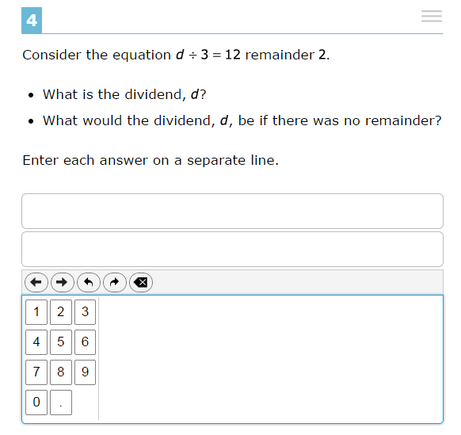
3rd Grade Math Test Example
Previous Test Question
Bob has 24 pieces of candy. He wants to give it all away to his 3 friends. He wants them all to get in equal amounts. How many pieces will Bob’s friends each get?
4
6
7
8
AzMERIT Sample Test Question
Notes:
Students will:
Show their work and demonstrate that they understand a concept in addition to memorizing the formula.
Compute math problems quickly and accurately.
Know multiple ways to solve problems, allowing them to choose the method that is best.

Slide 15
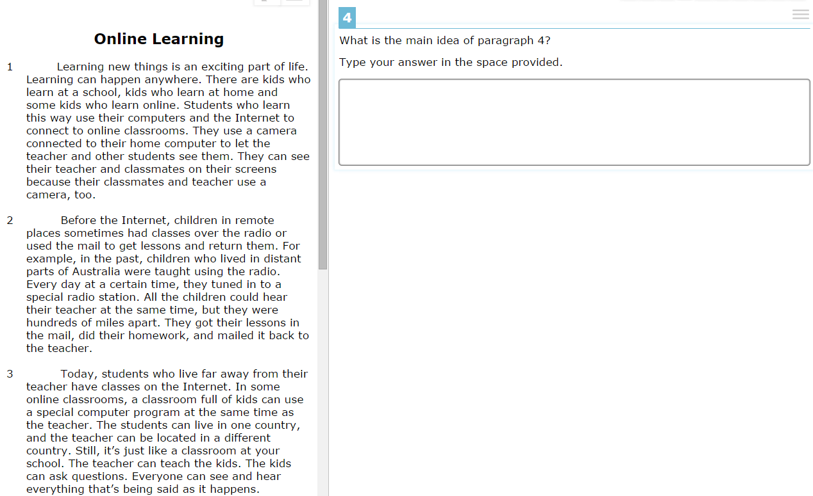
EXAMPLE:3rd Grade ELA Test
3rd Grade ELA Test Example
Previous Test Question
In the story “A Fetching Rescue”, what is Paragraph 18 mainly about?
  Tyler uses his strong legs to swim across the lake.
  Tyler makes a huge splash in the water.
  Tyler swims toward something that has fallen in the lake.
  Tyler watched small rocks fall into the water.
AzMERIT Sample Test Question

Slide 16

How to Interpret Test Results
Notes:
After the test, you may be wondering – what does this all mean? How can I use the results from AzMERIT to help my child?

Slide 17


AzMERIT Video
Notes:
If you have internet access, play the video (it is 1 minute 42 seconds long)
https://www.youtube.com/watch?v=9_qJMDYnaeo
Let’s watch this short video that helps demonstrate the importance of getting accurate and meaningful information through AzMERIT.

Slide 18
What Will Scores Look Like?
New test = new scores
We are setting a new benchmark for student performance
Scores will look different than before, but it doesn’t mean our students are doing worse – instead, it’s more accurate view of how our students are doing
Students and teachers will need time to adjust to the new test
Notes:
I know many of you are probably wondering, what will scores look like?
It is important to know that with a new test comes new scores.
With AzMERIT, the bar has been raised to a college and career ready level. We did not have that before.
Before, the bar was set at a 10th grade level. Essentially we were telling our students that if they passed our old test they were ready to go into the world. The reality is that they were only ready for 11th grade.
Now, with AzMERIT, we will have a more realistic view of how our students are doing as they get ready for life after high school – whether it is in college, the workplace, the military or other training programs.
So given this, we should expect that our scores will look different than before.
This new bar cannot be compared to the old one.
The scores are not higher or lower, just different.
It doesn’t mean that our students are doing worse. Instead, the scores will provide a more accurate view of how our students are performing.
Both students and teachers will need time to adjust to the new assessment. With time and support, we know Arizona students will rise to the challenge.

Slide 19
When Will I Get My Child’s Scores?
Initial test results will be available later this fall as we transition to the new test
Future test results will be available much more quickly
Student data will continue to be protected by state and federal laws
Notes:
So when should you expect to receive your child’s scores?
Parents should expect to receive their child’s test results this fall – in late October or early November. It took a little longer this year because it is the first year of AzMERIT.
However, future test results will be available in the same school year.
And your child’s test data is protected by a number of state and federal laws. Personal student data has never been, and never will be, shared with the federal government.

Slide 20
What You Can Expect with Your Child’s Scores
Four Scoring Categories:
  Highly Proficient – Advanced understanding
  Proficient – Fundamental understanding
  Partially Proficient – Partial understanding
  Minimally Proficient – Modest understanding
Family Score Reports & a Family Guide will go to the families of each child who took AzMERIT last spring
Notes:
Another thing parents needs to know is that AzMERIT scores are in four categories:
Highly Proficient – Advanced understanding
Proficient – Fundamental understanding
Partially Proficient – Partial understanding
Minimally Proficient – Modest understanding
Your child will have a score in English and math in one of these four categories.
Parents will receive a Family Score Report for your Child’s English Language Arts scores and one for his math scores.
In addition, parents will also receive a guide with information on what is included in the family score reports.
These may go home in your child’s backpacks or mailed home – so please be sure to ask your child’s school when you should expect to see them.
NOTES
Highly Proficient students demonstrate an advanced understanding of and ability to apply the content knowledge and skills needed to be on track towards college and career readiness as specified in Arizona’s Mathematics and English Language Arts Standards. (Level 4)
Proficient students demonstrate a fundamental understanding of and ability to apply the content knowledge and skills needed to be on track towards college and career readiness as specified in Arizona’s Mathematics and English Language Arts Standards. (Level 3)
Partially Proficient students demonstrate a partial understanding of and ability to apply the content knowledge and skills needed to be on track towards college and career readiness as specified in Arizona’s Mathematics and English Language Arts Standards. (Level 2)
Minimally Proficient students demonstrate a modest understanding of and ability to apply the content knowledge and skills needed to be on track towards college and career readiness as specified in Arizona’s Mathematics and English Language Arts Standards. (Level 1)

Slide 21

Sample Family Score Report
Notes:
Here’s a preview of a sample family score report.
The AzMERIT score reports will be designed to provide better information on how your child is progressing and where he or she might need more help. Score reports for both English Language Arts and Math will give an overall measure of how your child performed individually and when compared to other students in the state. This will allow you to have peace of mind at every grade level if your student is on track for the next grade and college
The score reports will include more than just a number. They will also include your how well your student mastered specific concepts and skills within each subject. And if they have areas in particular where they have more difficulty, it allows teachers to identify these areas and implement extra supports or interventions
Features of this report:
One report per content area (ELA and math)
Each report is a single page printed on both side in full color.
The front of the report will have “About this Report” text; your child’s proficiency level and scale score; the average scale scores for the school, district, and state; brief proficiency level descriptors.

Slide 22

Sample Family Score Report
Notes:
On the back, you will be able to see more detailed information about your child’s progress in specific content areas.

Slide 23
Sample Family Report Guide
Notes:
Parents will also receive a guide with information on what is included in the family score reports.
This explains each section of the report and goes into additional detail about what each part of the score report includes.

Slide 24

How Do Teachers Use Test Data
Notes:
After the test, you may be wondering – what does this all mean? How can I use the results from AzMERIT to help my child?

Slide 25
AzMERIT is Not the Finish Line
Test results will be used to:
  Make instructional decisions
  Determine individual needs of students:
    Extra support?
    More challenging work?
    Recommendations for future classes?
Scores do not impact final grades, GPAs, class rank or college acceptance
Notes:
Remember, AzMERIT and other standardized tests are not the finish line.
They simply serve as check points along every child’s educational journey.
With very few exceptions, testing results should be used to determine areas of strength and weakness so students can monitor and adjust.
Test results will be used to:
Make instructional decisions.
Determine individual needs of students:
Extra support?
More challenging work?
Recommendations for future classes?
Scores do not impact final grades, GPAs, class rank or college acceptance.

Slide 26
How Teachers Use Data
Determine how students are doing compared to their own past performance and to peers
Communicate better to parents about progress
Evaluate effectiveness of curriculum and instruction
Decide teaching strategies to adjust
Facilitate professional conversations with other educators
Notes:
Standardized tests are one way teachers can determine how students are doing in relation to their own past performance and in comparison to their peers.
Teachers also use test data to communicate progress toward the overall goal of career and college readiness. It is just one way that they can better communicate to families about student progress.
Help to determine the effectiveness of curriculum and instruction. If the assessment is well aligned to the standards it will help teachers to determine if what they are doing each day is having the desired impact. Test scores in conjunction with a number of other data points allow teachers to use professional judgment to determine which strategies they might want to adjust. It also allows teachers to have professional conversations with other educators around the state about what is working well and what might need to be changed so they can be most effective with their students.

Slide 27

Helping Your Child Succeed
Notes:
All of the work your child is doing in the classroom throughout the year will help him or her prepare for this test. Every project, assignment and discussion helps teach your child develop critical thinking and problem solving skills.

Slide 28
Things You Can Do
Build a strong relationship with your child’s teacher
Attend your parent teacher conferences
Set high expectations for your child
Involve learning in everyday activities
Give time for your child and your child’s teacher to adjust to the new standards & new test
Notes:
Things You Can Do
You and your child’s teacher are the most influential in ensuring that your child gets a great education.
As parents, your partnership with your child’s teacher is a critical element in your child’s academic success.
Don’t just talk to your child’s teachers at back to school nights and parent-teacher conferences…
Commit to talking to him/them at least once a month.
Ask how your child is doing and focus on his academic progress.
Set shared goals for what your student needs to know and be able to do.
Ask how you can help your child learn at home.
Set high expectations for your child’s education. Set the bar high and be consistent. Help your child along the way and give him support and encouragement when he needs it.
Involve learning in everyday activities by mixing math into cooking or shopping. Ask your child to express opinions and to back their views.
Also, give some time for your child and your child’s teacher to adjust to the new standards. In the short term, you may see grades or test scores dip.
But as parents you can play a key role in encouraging your child and in providing him support when he needs it.

Slide 29
Other Ways You Can Help Your
Child Succeed
Have your child read a variety of materials at home, including fiction and informational texts.
Involve learning in everyday activities.
  Mix math into cooking or shopping.
  Ask your child to express opinions
  and to back their views.
Notes:
Reinforce problem-solving and critical thinking skills at home by reading with your child and asking her to talk about the central idea or theme of book or article.
Cooking together will reinforce measurement; doubling the recipe or halving the recipe will reinforce multiplication and purchasing the items will reinforce solving problems involving addition and subtraction.
Create a grocery shopping list with your child. Find the prices in the grocery ads and ask your child to
estimate the total amount of money needed to complete the shopping list.
Ask your child to explain something she has written or have her explain the steps she took to solve a math problem.

Slide 30
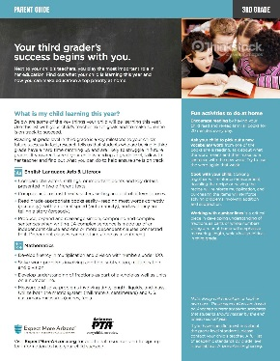
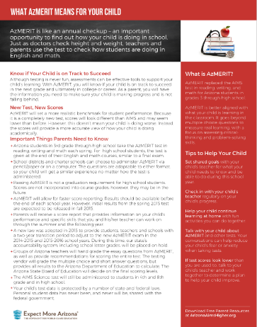

Parent Resources
ArizonaAimsHigher.org
Grade by Grade Parent Guides
AzMERIT Fact Sheet
Notes:
Expect More Arizona has a wealth of resources on the standards and assessments available on a dedicated website that you can access at ArizonaAimsHigher.org.
You can download an AzMERIT fact sheet that answers the most common questions heard from parents during AzMERIT testing this past spring.
You can also download Grade by Grade Parent Guides provide parents an overview of the key things their child will be learning in each grade (Kindergarten through high school), aligned with Arizona’s current education standards. Each grade sheet offers helpful activities parents can do at home to reinforce what students are learning during the school day.

Slide 31
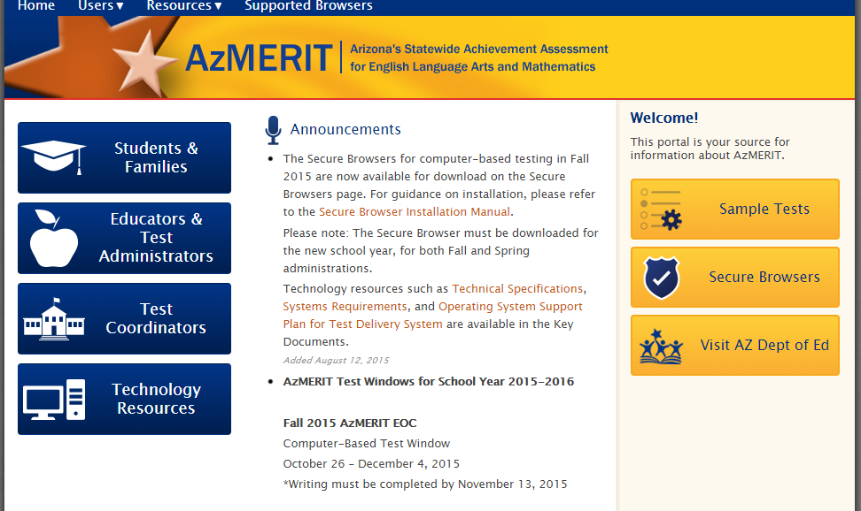
Sample Tests & Score Reports
Access sample tests and other resources online at: AzMERITportal.org
Notes:
You can access sample test questions and parent score reports from the Arizona Department of Education at: AzMERITportal.org.

Slide 32

You Can Help Your Child Succeed
Notes:
Arizona has tremendous potential to become a state known for high-quality education.
We can achieve our vision for a world class education if we make education – early years through career – our top priority.
Everyone has an important role to play. It is up to all of us to get involved. And there’s something for each of us to do.

Slide 33

Join the Movement
Sign Up
Get updates on AzMERIT and resources to help your child succeed
Notes:
Here are a few easy ways you can get involved.
Sign up! Join the movement.
By signing up you can:
--get updates on AzMERIT
--Get resources to help your child succeed

Slide 34


Slide 35
Appendix

Slide 36
Benefits of Online Testing
New test features - tools, reference sheets
New item types, not just multiple choice
More accommodations
Less expensive than paper tests
More engaging for students
Quicker reporting
Notes:
New Test Features – graphing calculators, eliminate answers by crossing off
More accommodations for special ed students – enlarged, different background colors,
Less expensive for grading and for districts/schools with time and effort in unpacking test booklets, crossing off
One computer per 10 students and adequate bandwidth to send responses to AIR
Paper tests will still be offered for next three years (length of the AIR contract)

Slide 37
How Will AzMERIT Impact Accountability
Move on When Reading
  Students will not be held back in 3rd grade this year
    Students can still receive support, scores still need to be determined
Teacher/Principal Evaluations
  A portion of test scores will be used, along with student growth.
School Letter Grades
  Letter grades will be redefined by SBE
Notes:
Accountability helps ensure:
-students are learning what they are supposed to be learning
-teachers are teaching what they are supposed to be teaching
-schools are providing supports to students and teachers
Last spring, a new law was adopted to provide students, teachers and schools with a two-year transition period to adjust to the new AzMERIT exam. Our state’s accountability system will be placed on hold, although the data will still be available for parents and teachers to know how students performed overall.
“Move on When Reading” is a state law requiring Grade 3 students to demonstrate a minimum level of reading ability to be promoted to Grade 4. Students will demonstrate their reading ability on the reading portion of AzMERIT. The first year of AzMERIT results will not be available until after the start of the 2015-2016 school year. Any student promoted to Grade 4 without a sufficiently high AzMERIT Grade 3 reading score will be entitled to receive additional reading support.
How will AzMERIT be used in the evaluation of teachers and principals? Once the Board decides upon a timeline, a portion of the evaluation of teachers and principals will be based on how well students perform on AzMERIT. Evaluations must also include the educational growth that students show over time. Districts and charters may also include other data in evaluations.
How will AzMERIT be used in the A-F Letter Grades for schools? The A-F Letter Grades that schools receive are largely based on how students perform on the statewide achievement test. The Board is currently discussing how AzMERIT results will be used to calculate A-F Letter Grades.

Slide 38
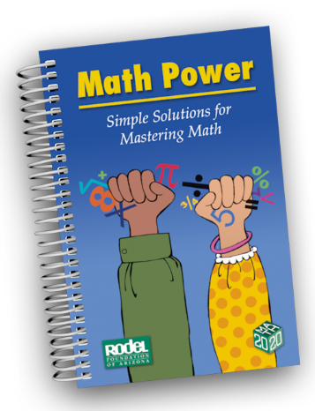
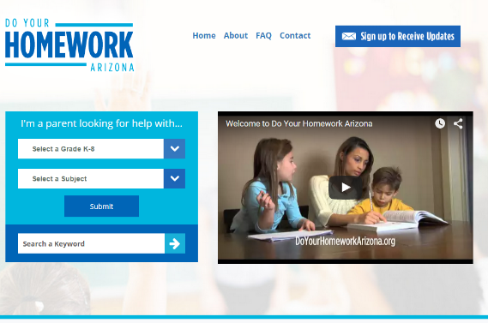

Additional Parent Resources
Rodel Foundation’s Math Power Book for Parents
Do Your Homework Arizona
Be A Learning Hero
The Homework Help Desk
National PTA Parents’ Guides to Student Success

